Slide 1
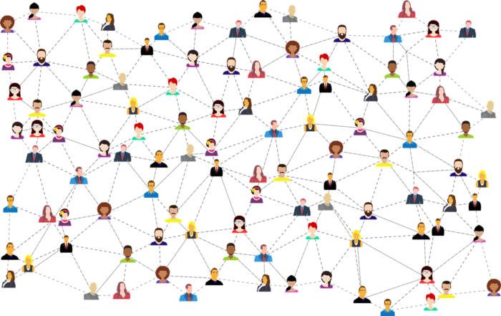
Open Recognition Networks
Stephen Downes
October 26, 2020
ePIC 2020 – 18th International Conference
https://www.downes.ca/presentation/526
Notes:
Recent technologies such as badges and blockchain have added a new dimension to online skills recognition. In a recent MOOC, Stephen Downes implemented both, and in this presentation will outline the process and technology employed. From this starting point, Downes will discuss the concept of recognition more broadly and explore how new forms and processes of recognition are now possible, leading to the development of open recognition networks. In addition to outlining the technology of open recognition networks and showing some examples, Downes will survey how they interoperate with other technologies, such as competencies and skills analytics, and discuss some of the potential social, ethical and cultural challenges such systems introduce.

Slide 2

Competencies and Stackable Credentials
Notes:
This post is an introduction to a short report (6 page PDF) on a company called Avature, which provides recruiting and onboarding technology for large companies. It reads a lot loke marketing content, so take it with a grain of salt. It's worth noting here because of the role recruitment tools play in the online learning ecosystem - after all, for many people, the output of online learning is the input for recruitment (put that way it sounds really crass, but that's the way to think of it). And the caution here is to avoid designing for specific recritment objectives - becuse the goal of recruitment technology is flexibility. This is going to be especially the case for competency requirements and job qualifications. "As a company starts to tweak, adapt, and expand its recruiting practices, there are always new workflows, business rules, and reports to add. Recruiting is not a transactional process – it’s more like a continuous flow – so the platform has to be adaptable and easy to change." https://joshbersin.com/2020/10/the-new-world-of-adaptable-hr-software-avature-sets-the-pace/

Slide 3
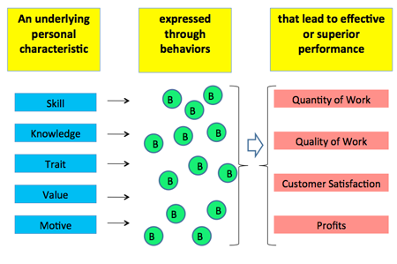
What are Competencies?
http://cornwellinc.com/tools/competency/description.html
Notes:
From: http://cornwellinc.com/tools/competency/description.html
What Are Competency Models?
A competency model is a detailed, behaviorally specific description of the skills and traits that employees need to be effective in a job.
Characteristics of a Competency Model:
Between 18 and 20 competencies, with definitions.
Describes what is needed for effective or superior performance for a specific job.
Often grouped in 3 to 5 clusters.
Each competency may have a set of behavioral indicators.
Knowing the competencies for a job enables one to select jobholders who already possess some of the competencies and are therefore more likely than other candidates to achieve effective or superior performance and to receive rewards and recognition that cause them to remain in the organization.
What are competencies?
A competency is a trait, characteristic, skill or knowledge that is needed to perform a particular job. A competency can be technical, non-technical or foundational.

Slide 4
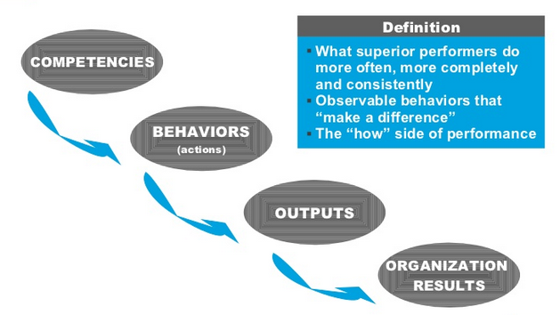
Evaluating Competencies?
David Gay https://www.slideshare.net/davidgay/overview-of-competencies-benefits-and-uses-of-a-competencybased-system
Notes:
From:
Overview Of Competencies & Benefits and Uses of a Competency-Based System
David Gay, Communications Assistant at State of CA Dept of Personnel Admin
Published on Jul 25, 2008 https://www.slideshare.net/davidgay/overview-of-competencies-benefits-and-uses-of-a-competencybased-system
From:
Invited Commentary: The Time is Now! Creating Technology Competencies for Teacher Educators
Teresa S. Foulger; Kevin J. Graziano; David Slykhuis; Denise Schmidt-Crawford; Torrey Trust
Journal of Technology and Teacher Education Volume 24, Number 3, July 2016 ISSN 1059-7069 Publisher: Society for Information Technology & Teacher Education, Waynesville, NC USA
https://www.learntechlib.org/p/174099/
What are Competencies?
Competencies have been defined as “knowledge, skills, or attitudes
that enable one to effectively perform the activities of a given occupation or
function to the standards expected in employment” (Richey, Fields, & Fox-
on, 2001, p. 31). A comprehensive definition of competencies comes from
researchers Spencer and Spencer (1993) related to workplace competency:
integrated skills, knowledge, and attitudes that are essential to success in the
workplace, and may involve personal values and self-motivation, which are
both observable and nonobservable.
The term competencies can be traced back to Boyatzis’s (1982) book
The Competent Manager: A Model for Effective Performance. Since this
work was published, the term competency has been used synonymously
with terms such as standards, learning objectives, and skills; however, a
competency is a multidimensional concept (Hoffmann, 1999) and is unique-
ly different from each of these terms:
● Standards are used to measure or evaluate success.
● Learning objectives are statements that describe the outcomes of a
learning activity in terms of skills, knowledge, and attitudes.
● Skills are part of competencies, but competencies are more than
just skills.

Slide 5
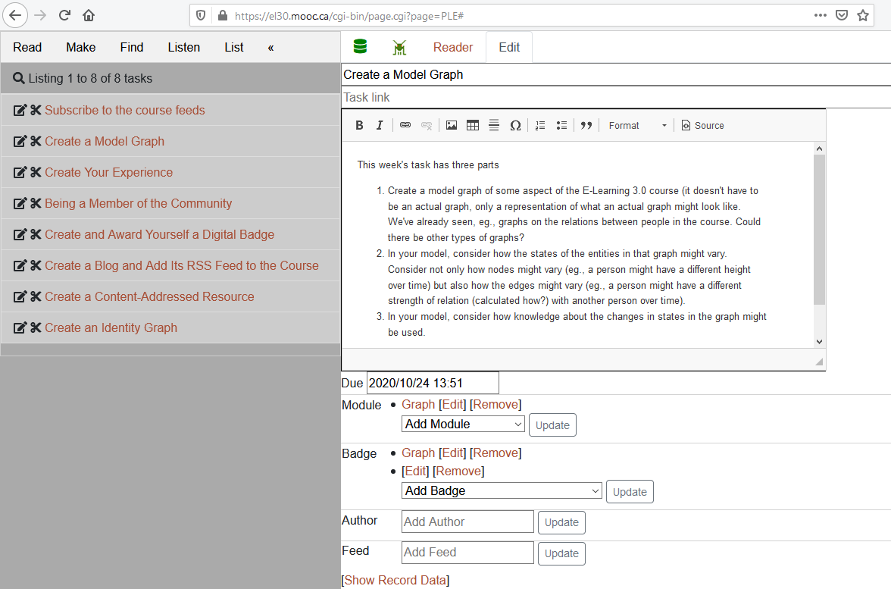
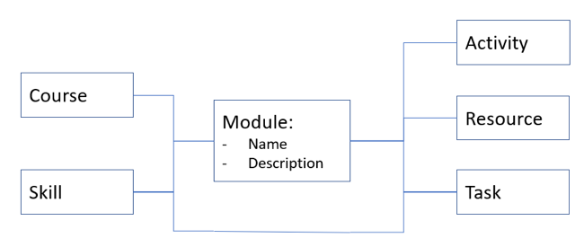
Skills and Tasks

Slide 6
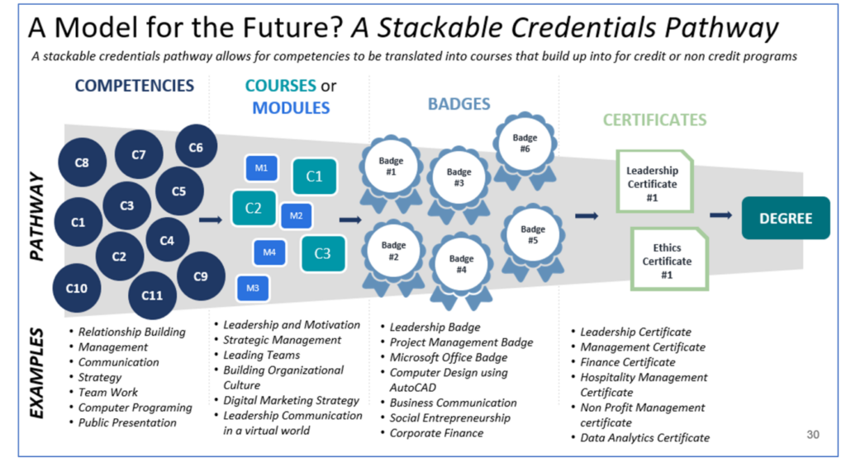
Stackable Credentials
Jim Fong, UPCEA, “Faster Forward to a New Economy and Implications for Higher Education,” Presentation. August 6, 2020.
Notes:
UPCEA, “Faster Forward to a New Economy and Implications for Higher Education,” Presentation. J. Fong, August 6, 2020. https://www.youtube.com/watch?v=8PeppLxYh3Q&feature=emb_logo
Image from presentation: https://www.eventbrite.com/e/faster-forward-to-a-new-economy-and-implications-for-higher-ed-english-tickets-113774819548

Slide 7
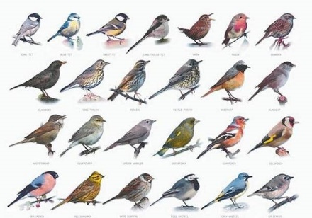
Badges and Blockchain

Slide 8
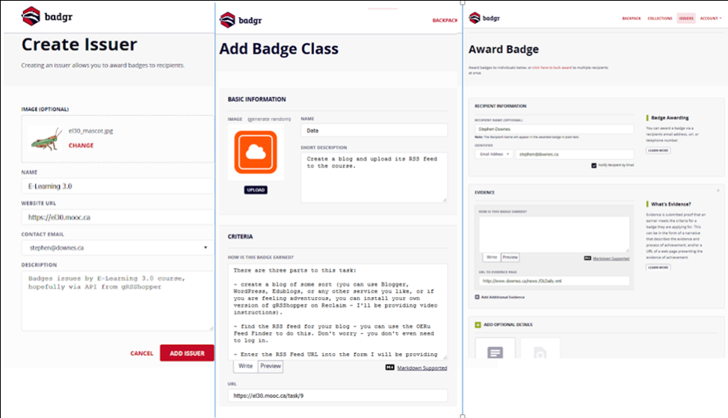
Badge Infrastructure
https://info.badgr.com/
https://badge.wiki/wiki/Badge_platforms
Notes:
https://info.badgr.com/
https://badge.wiki/wiki/Badge_platforms
1 Accredible
2 Badgecraft
3 Badge List
4 BadgeFactor
5 BadgeOS
6 Badgetree
7 Badgr
8 BCdiploma
9 Bestr
10 CanCred.ca
11 Canvabadges
12 Create by Mouse
13 Credly
14 ForAllRubrics
15 Makewaves
16 NOCTI and Nocti Business Solutions (NBS)
17 Learning Objects
18 Open Badge Academy
19 Open Badge Factory
20 Openbadges.me
21 Peer 2 Peer University (P2PU)
22 ProExam Vault
23 RedCritter
24 Remix Learning
25 Youtopia

Slide 9
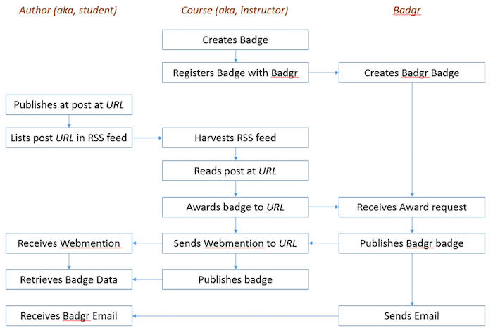
Badge Workflow
https://jl4d.org/index.php/ejl4d/article/view/348/436

Slide 10
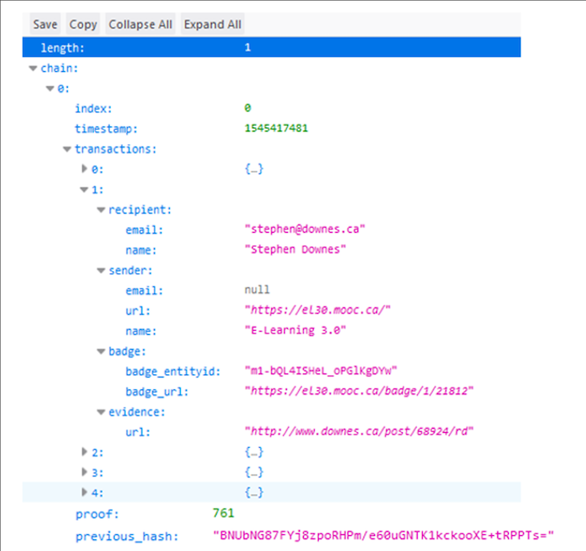
Recording on Blockchain
https://github.com/Downes/blockchain
Notes:
Blockchain and Public Record Keeping: Of Temples, Prisons, and the (Re)Configuration of Power
Victoria L. Lemieux School of Library, Archival and Information Studies, University of British Columbia, Vancouver, BC, Canada. Frontiers in Blockchain., 2019.
“As a distributed ledger, blockchain technology is, at its heart, a record keeping technology. Without going into technical details of its operation, aspects of which will be discussed later in this paper, and which are quite varied across different blockchain platforms in any case, it is in large part due to the intended making and keeping of tamper-resistant and transparent recordings of transactions that is said to make blockchains trustworthy (Nakamoto, 2008; Peters and Panayi, 2016; Atzori, 2017). “

Slide 11
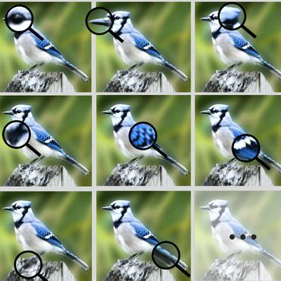
A Proliferation of Certifications

Slide 12
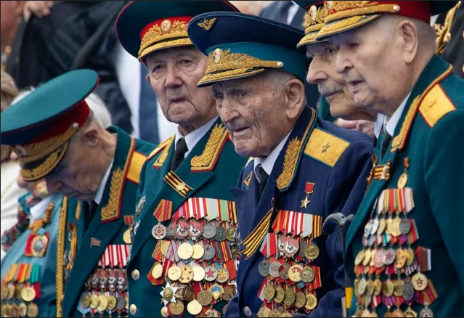
How Many is Enough?
https://asiatimes.com/2020/03/russia-puts-a-lid-on-military-medals/
Notes:
Credential Engine:
https://credentialengine.org/counting-credentials-2019-report/
This new report from Credential Engine moves us forward—performing an extensive count and using computational models, when necessary, to estimate that the United States has at least 738,428 unique credentials.
This estimate, which is the result of a much broader and deeper analysis than the preliminary one we published in April 2018, more than doubles that early estimate of 334,114.2 This larger number is primarily the result of being able to include for the first time sizable portions of the credential ecosystem—badges and certificates—that were not able to be counted in our first report.
This report looks at 17 credential categories that fall into four types of education: postsecondary educational institutions, massive open online course (MOOC) providers, non-academic organizations, and secondary schools. It finds that postsecondary institutions are the largest type of credentialing organization, but they are closely rivaled by non-academic organizations.
In fact, our estimate of the number of credentials from non-academic organizations—notably, including badges—grew substantially from our preliminary accounting to the current accounting. Specific findings include:
•370,020 credentials issued by postsecondary educational institutions, including both those that participate in Title IV and those that do not;
•7,132 credentials from MOOC providers, the vast majority of them being course completion certificates;
•315,067 credentials from non-academic organizations, with the largest categories being digital badges and online course completion certificates; and
•46,209 credentials from public and private secondary schools.
------
With 475,000 options, does America have too many non-degree credentials or too few?
https://qz.com/work/1715372/the-number-of-digital-badges-and-other-non-degree-credentials-is-ballooning/

Slide 13
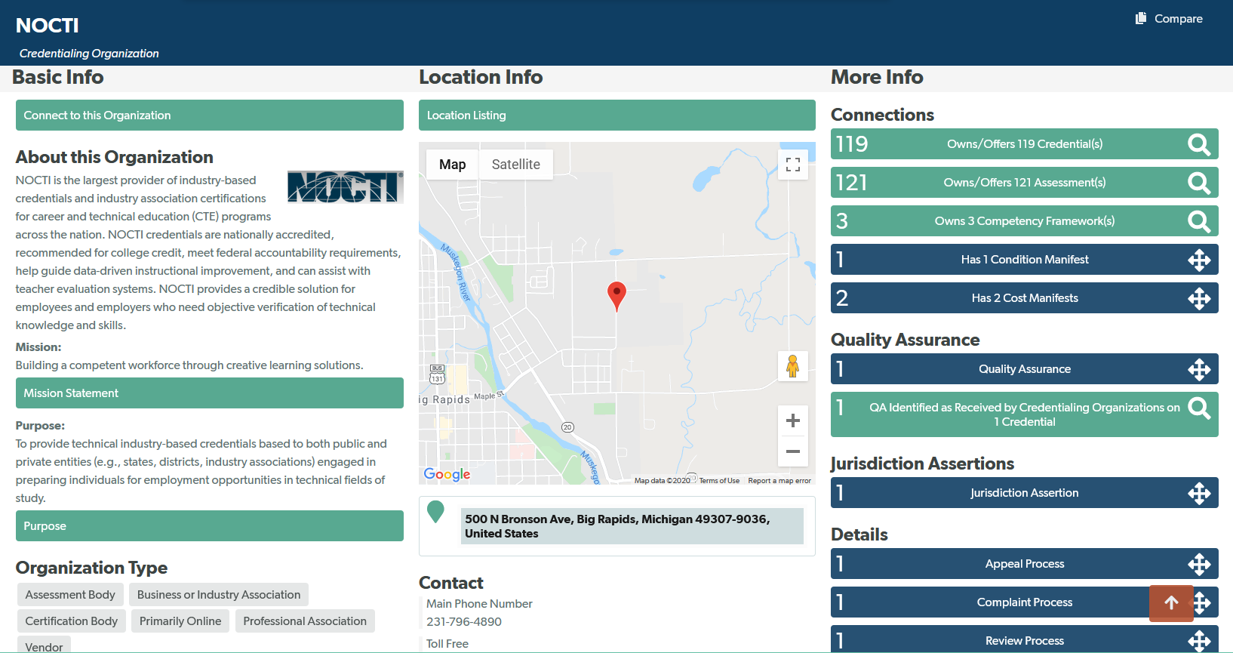
Credential Organizations
https://credentialfinder.org/organization/1
Notes:
https://credentialfinder.org/organization/1

Slide 14
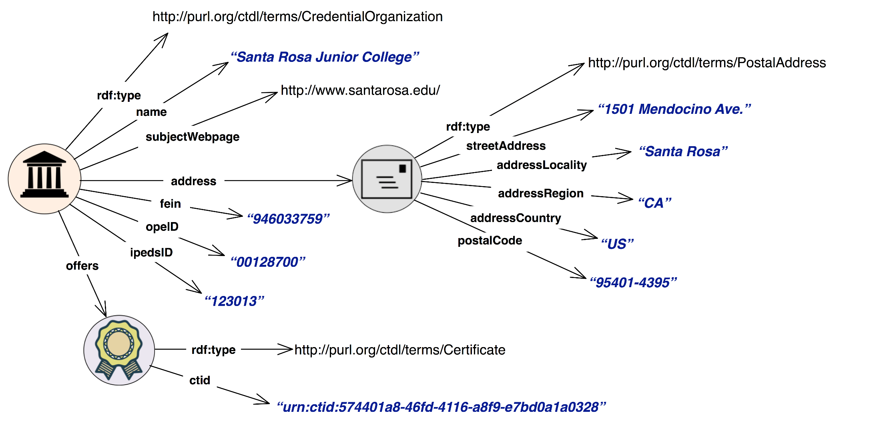
Credential Transparency
https://credreg.net/ctdl/handbook
Notes:
the Credential Transparency Description Language, or CTDL—creating a dictionary of terms that provides a common approach to describing all types and levels of credentials, from diplomas, badges, certificates, Navigating the Credential Marketplace: A How-to Guide
Educause - 7 Things You Should Know About Credential Transparency Description Language
https://library.educause.edu/resources/2018/12/7-things-you-should-know-about-credential-transparency-description-language
Credential Finder - https://credentialfinder.org/ (19449 results)

Slide 15
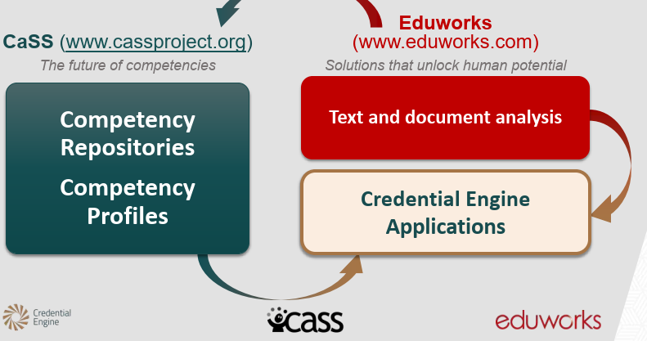
Credential Applications
https://www.slideshare.net/CredentialEngine/cass-application
Notes:
https://credentialengine.org/about/credential-registry-overview/user-applications/applications-showcase/
Academy One – will my credential transfer? https://www.academyone.com/higher-ed-software-and-technology-solutions/will-my-credits-transfer
LRNG - https://www.lrng.org/ - LRNG enables you to access both local and national opportunities from your computer, smartphone, or tablet.
CASS – http://www.cassproject.org

Slide 16
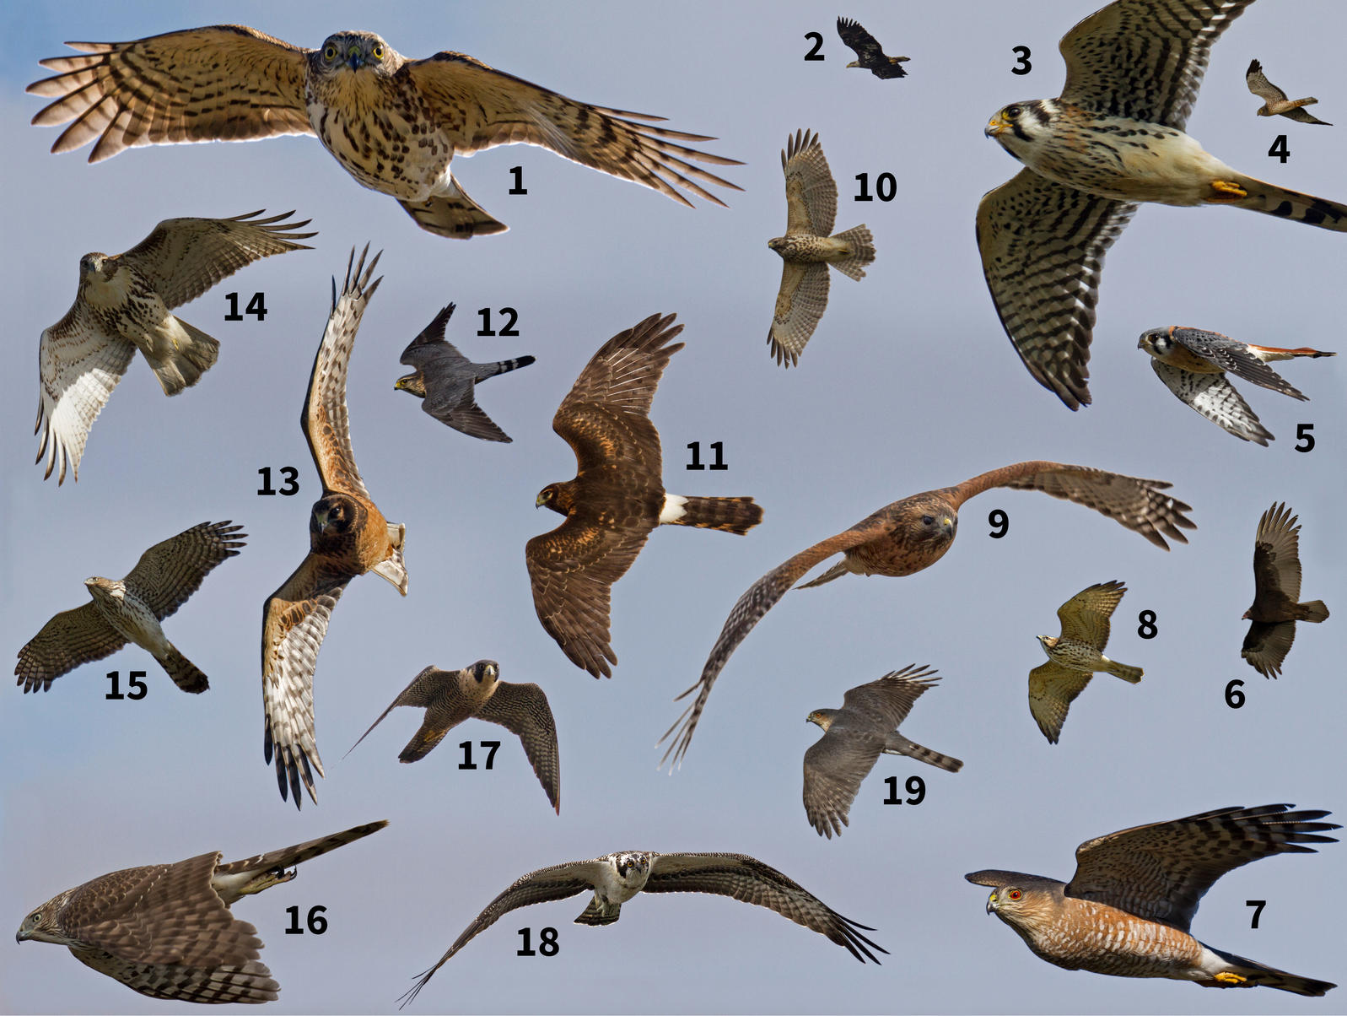
How do we evaluate certifications

Slide 17
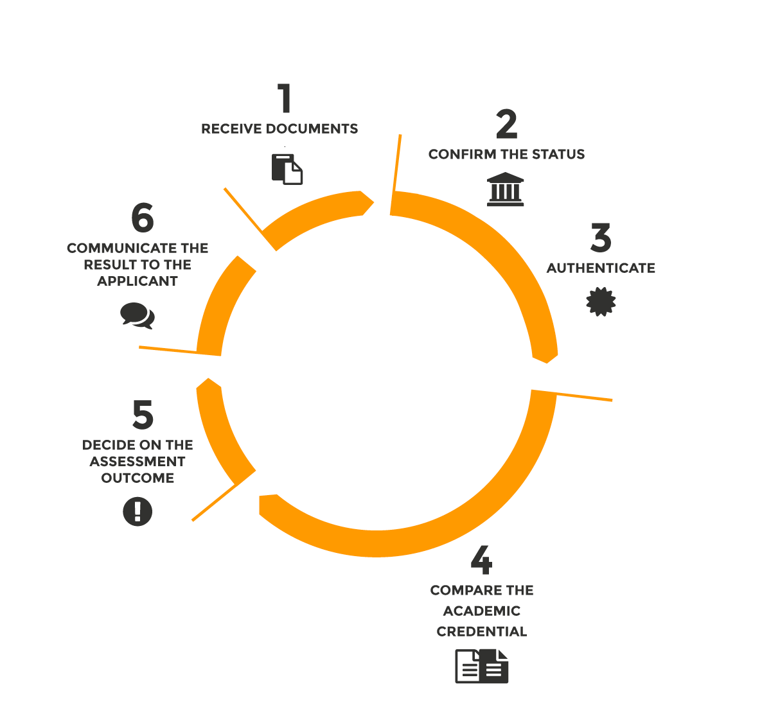
Credential Evaluation Services
https://www.cicic.ca/1566/overview.canada
Notes:
https://canalliance.org/en/
Alliance of Credential Evaluation Services of Canada
Pan-Canadian Quality Assurance Framework for the Assessment of International Academic Credentials (QAF)
https://www.cicic.ca/1504/consult_the_pan_canadian_quality_assurance_framework_for_the_assessment_of_international_academic_credentials_(qaf).Canada
(54 point checklist)

Slide 18


This is Microsoft grifting, no?
https://github.githubassets.com/images/modules/site/downloads/certifications/GitHub.Certified.Practitioner.Exam.skills-outline.pdf
https://m.tzyl.nl/@ton/105080168060564907
Notes:
https://github.com/certifications
https://www.the74million.org/wp-content/uploads/2020/10/Screen-Shot-2019-07-08-at-3.31.18-PM.jpg
s. Walmart has partnered with Guild Education and a few other providers to help connect their employees to different kinds of educational opportunities,
the JetBlue scholars program. JetBlue is evaluating the prior post-secondary education of employees, many of whom have earned some college credits but no degree.

Slide 19
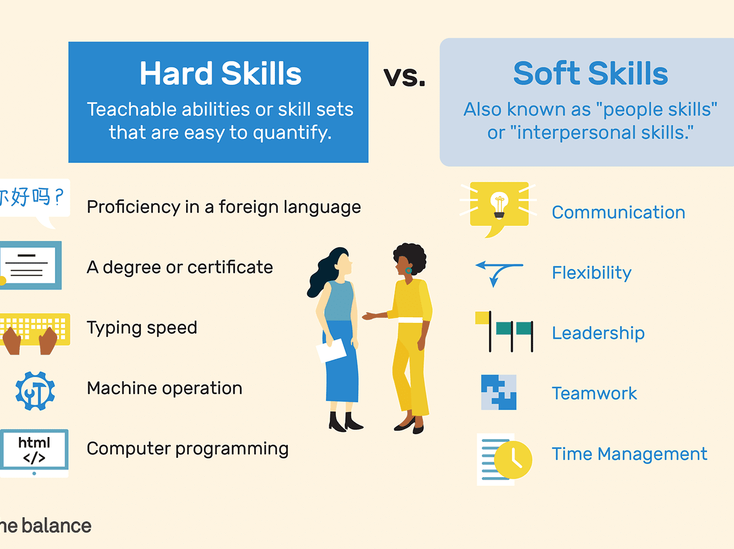
In Whose Interest?
https://www.thebalancecareers.com/hard-skills-vs-soft-skills-2063780
Notes:
The 74 Interview: Researcher Martin Kurzweil on Why More Data is Needed to Prevent Fraud and Confusion in the Non-Degree Credential Landscape
https://www.the74million.org/article/the-74-interview-researcher-martin-kurzweil-on-why-more-data-is-needed-to-prevent-fraud-and-confusion-in-the-non-degree-credential-landscape/
Risks (Kurzweil)
a credential generated by one employer may not be portable to another employer.
Scaling back education and training and related benefits does not seem to have been a major focus of corporate cutbacks
third risk is that the kinds of credentials or education or training opportunities that employers encourage their employees to pursue are those in the employer’s short-term interest and not necessarily in the employees’ long-term interest.
https://www.the74million.org/article/the-74-interview-researcher-martin-kurzweil-on-why-more-data-is-needed-to-prevent-fraud-and-confusion-in-the-non-degree-credential-landscape/

Slide 20

Credential Transfer
https://www.academyone.com/higher-ed-software-and-technology-solutions/will-my-credits-transfer
Notes:
“Many institutions list transfer agreements in or out, course equivalencies in or out, pages of text guidance, videos and more. Stepping through the transfer universe can be daunting and a maze of information. What if you make it simpler for transfer students to
Many institiutions list transfer agreements in or out, course equivalencies in or out, pages of text guidance, videos and more. Stepping through the transfer universe can be daunting and a maze of information. What if you make it simplier for transfer students to research and review their transfer opportunities you offer? research and review their transfer opportunities you offer?”

Slide 21

Childfolio
https://www.childfolio.com/
Notes:
Ummm… ick?

Slide 22
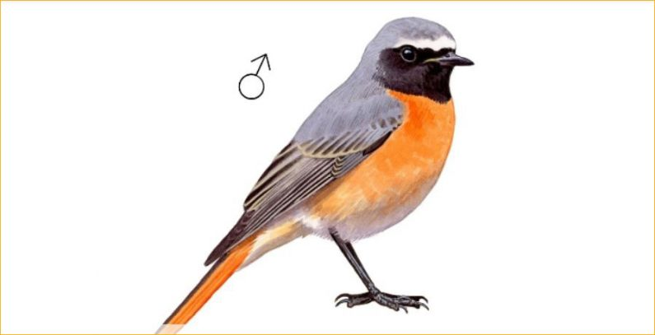
Forms of Recognition
Notes:
tools for onboarding, career management, diversity reporting, performance and goal management, social recognition, and the list goes on. https://joshbersin.com/2020/10/the-new-world-of-adaptable-hr-software-avature-sets-the-pace/

Slide 23
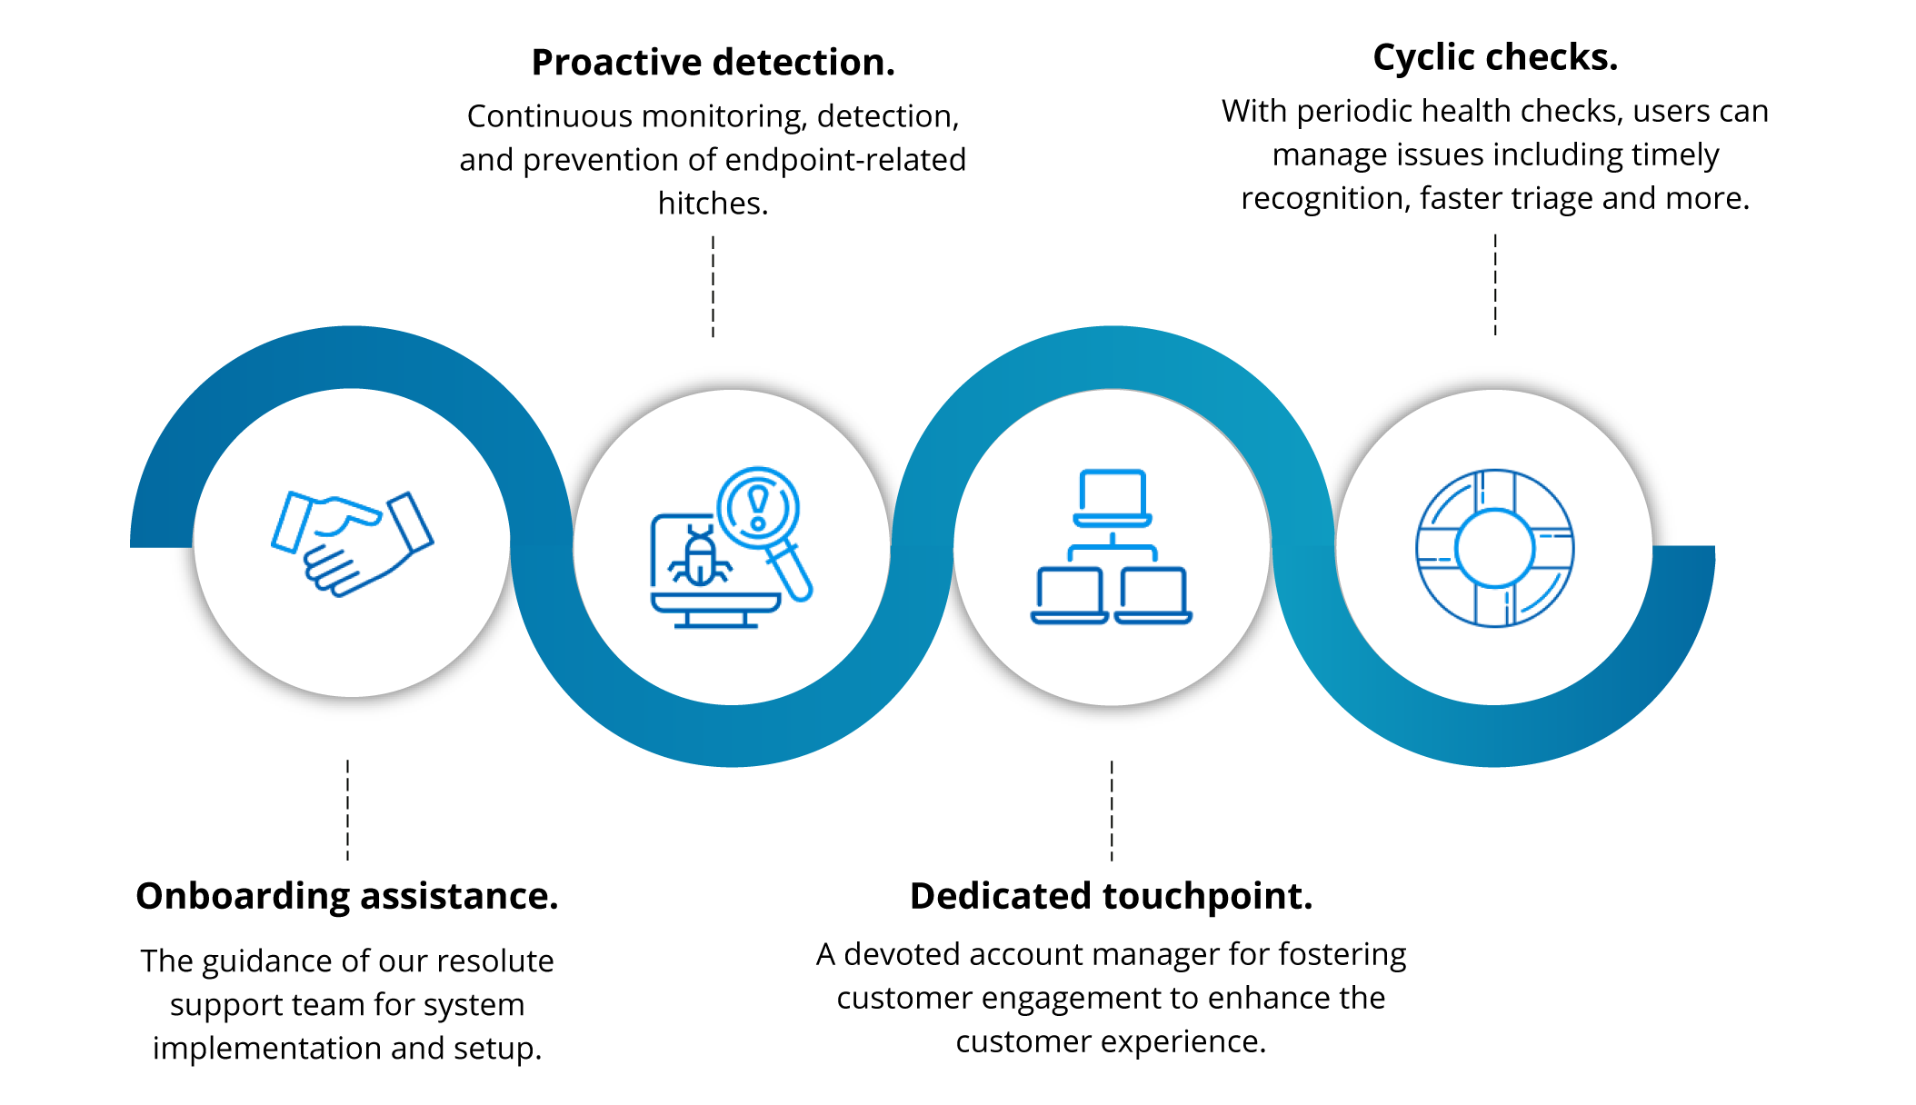
Onboarding
https://www.manageengine.com/products/desktop-central/customer-onboarding.html
Notes:
Saunderson, Make Your Onboarding Recognition More Meaningful https://authenticrecognition.com/make-your-onboarding-recognition-more-meaningful/
Welcome package
first day card
Greetings
https://mtmrecognition.com/2019/08/ten-onboarding-ideas/
https://www.kudos.com/resource/blog/4-effective-ways-to-introduce-new-employees-to-recognition/
Pair new employees with recognition ambassadors
Allow new employees to experiment with,
Image: ManageEngine - https://www.manageengine.com/products/desktop-central/customer-onboarding.htmland give feedback on, your recognition strategies

Slide 24
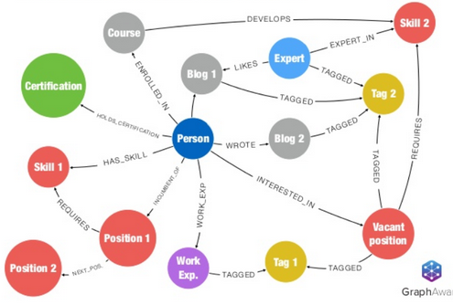
Career Management
https://neo4j.com/blog/neo4j-critical-aspect-human-capital-management-hcm/
Notes:
Eg. Neo4j as a Critical Aspect of Human Capital Management (HCM)
Luanne Misquitta Picture Luanne Misquitta, Principal Consultant, GraphAware Apr 11, 2018
https://neo4j.com/blog/neo4j-critical-aspect-human-capital-management-hcm/
Eg. "Human Potential Management" – (using a clustering mechanism –
Clustering employees on the basis of their cognitive and emotional knowledge and analysing their exploratory and exploitative innovations: A case study in a service company
January 2013 International Journal of Business Innovation and Research 7(6):679-698
DOI: 10.1504/IJBIR.2013.056741
Authors: Asghar Moshabaki; Dabestani Reza; Mohammad Saljoughian
https://www.researchgate.net/publication/263235748_Clustering_employees_on_the_basis_of_their_cognitive_and_emotional_knowledge_and_analysing_their_exploratory_and_exploitative_innovations_A_case_study_in_a_service_company

Slide 25

Diversity and Inclusion
Wolfberg, et. al. Recognizing diversity at multiple levels - https://www.sciencedirect.com/science/article/pii/S0885200699800325
Image: Deloitte - https://www2.deloitte.com/us/en/insights/topics/talent/six-signature-traits-of-inclusive-leadership.html
Notes:
Deloitte: 6 signature traits of an in clusive leader
https://www2.deloitte.com/us/en/insights/topics/talent/six-signature-traits-of-inclusive-leadership.html
Detecting how diverse and inclusive a classroom culture is
Early Childhood Research Quarterly
Volume 13, Issue 1, 1998, Pages 185-209
Early Childhood Research Quarterly
The culture of inclusion: Recognizing diversity at multiple levels
Author links open overlay panelMarci J.Hanson
PamelaWolfbergCraigZercherMariaMorganSonyaGutierrezDeidreBarnwellPaulaBeckman
https://doi.org/10.1016/S0885-2006(99)80032-5
https://www.sciencedirect.com/science/article/pii/S0885200699800325
Belonging and Membership
Interpreting Social Cues and Behavior. On many occasions, children were sensitive to the subtle and even obscure
Helping, Guiding and Protecting Others. Many children showed persistent efforts to help, guide and protect children who were less experienced or capable than themselves.
Seeking Adults for Approval, Interpretation and Assistance. Children addi- tionally sought out adults for approval, interpretation and assistance to negotiate the boundaries of peer culture.
Barriers
Disability Influences and Behavioral Differences. At times, peers merely overlooked social overtures of children with disabilities.
anguage and Communication Issues. A major barrier to belonging was the failure of children to communicate because of a child's disability or because children did not share a common language.

Slide 26
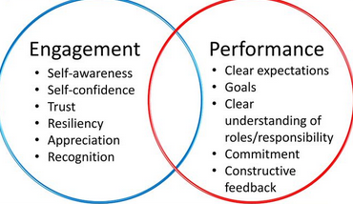
Performance and Goals
https://slideplayer.com/slide/13572624/
Notes:
https://slideplayer.com/slide/13572624/ Performance and Development Cycle, Buck Manning 2017 University of Victoria

Slide 27

Peer Recognition
Notes:
Unlock culture with ongoing recognition and feedback.
Hi5 is an app that helps you measure and promote appreciation, goals, culture and happiness across your entire company.

Slide 28
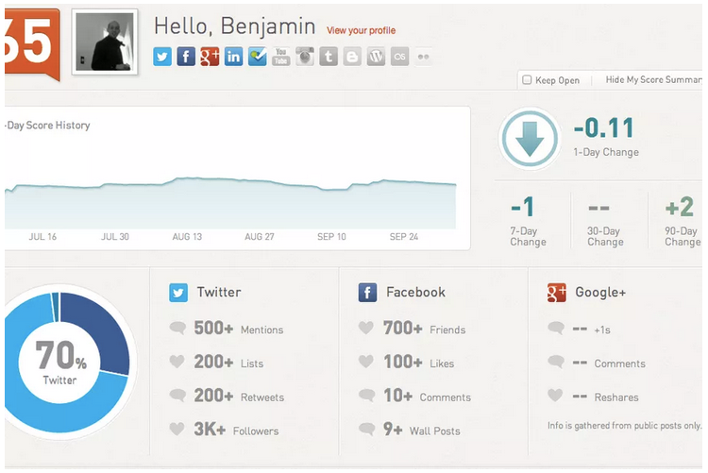
Doing it Wrong: Klout
https://www.theverge.com/tldr/2018/5/10/17340714/klout-lithium-social-media-reputation-tool-clout
Notes:
The Verge - Klout is out and there’s nary a pout: No more arguing about your useless score
By Shannon Liao May 10, 2018, 3:35pm EDT
https://www.theverge.com/tldr/2018/5/10/17340714/klout-lithium-social-media-reputation-tool-clout
Social Media Today. Wanna' Know How Your Klout Score is Really Calculated? https://www.socialmediatoday.com/social-business/adhutchinson/2015-10-31/wanna-know-how-your-klout-score-really-calculated
Andrew Hutchinson Oct. 31, 2015
“"In this work, we present the Klout Score, an influence scoring system that assigns scores to 750 million users across 9 different social networks on a daily basis. We propose a hierarchical framework for generating an influence score for each user, by incorporating information for the user from multiple networks and communities. Over 3600 features that capture signals of influential interactions are aggregated across multiple dimensions for each user. The features are scalably generated by processing over 45 billion interactions from social networks every day, as well as by incorporating factors that indicate real world influence." “

Slide 29
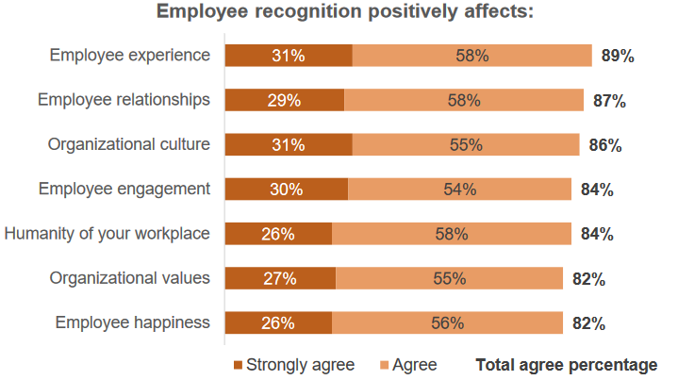
Recognition in the Workplace
https://www.shrm.org/hr-today/trends-and-forecasting/research-and-surveys/Documents/SHRM-GloboforceEmployeeRecognition%202018.pdf
Notes:
https://www.shrm.org/hr-today/trends-and-forecasting/research-and-surveys/Documents/SHRM-GloboforceEmployeeRecognition%202018.pdf
two-thirds of HR professionals agree employee recognition helps with retention
Employee recognition improves workplace culture, HR says
Effective recognition programs are linked to organizational values and talent strategy
How do you recognize – popularity contests? Competitions?
Form of recognition? Attaboy? Award? Promotion?

Slide 30
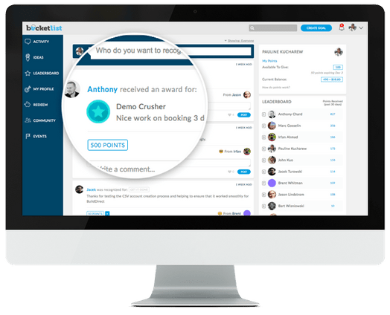
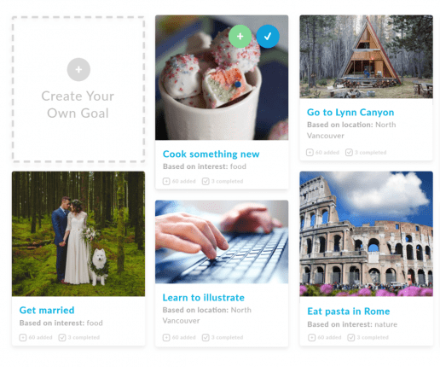
Employee Recognition Tech
http://unbouncepages.com/bucketlist-employee-recognition-software/
Notes:
https://www.capterra.com/employee-recognition-software/
BucketList - http://unbouncepages.com/bucketlist-employee-recognition-software/ (but notice how loopy the descriptions are – eg/. ‘Get married. Based on interest: food; Eat pasta in Rome, based on interest: nature )
Preciate: https://join.preciate.com/preciate-demo
Kidos, Guusto, etc

Slide 31
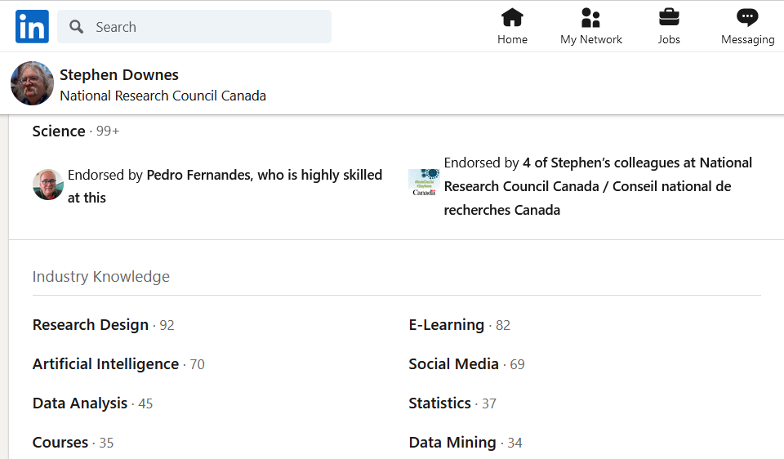
Social Media Recognition
https://www.linkedin.com/in/stdownes/
Notes:
OneHub – Recognition - https://www.hellobenefex.com/onehub/reward-recognition/
But more commonly – LinkedIn

Slide 32
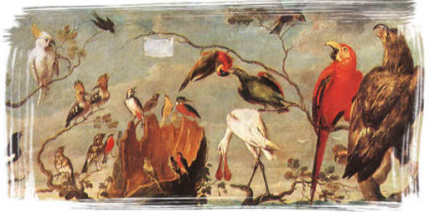
Knowing as Recognition
Notes:
Knower as an ethical concept: From Epistemic Agency to Mutual Recognition https://ojs.lib.uwo.ca/index.php/fpq/article/view/6228/4985
Matthew Congdon
(Recognition is not causation; it is based on association, not cause – eg. Vitamin D & Covid )
The Philosophical Foundations of Human Cognition (Section II)
2004 Edward G. Rozycki
Part 3 : Recognition and Knowing
https://www.newfoundations.com/CogTheo/CogTheo2.html

Slide 33
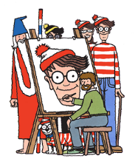
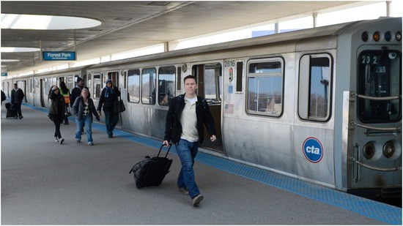
Seeing
Notes:
Seeing is recognizing

Slide 34
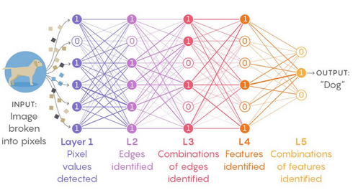
Recognition
Steve Easterbrook - https://scentroid.com/wp-content/uploads/2020/02/Steve-Easterbrook-Machine-Learning-and-Atmospheric-Modelling-A-Prognostic-View.pdf
Notes:
We are not teaching people what to know, we are teaching them how to see

Slide 35
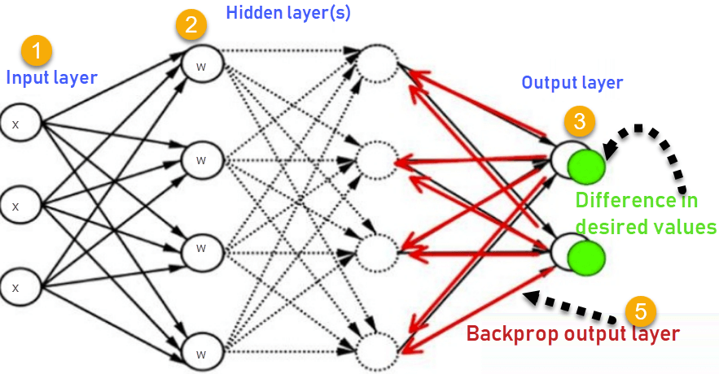
Learning
https://www.guru99.com/backpropogation-neural-network.html

Slide 36
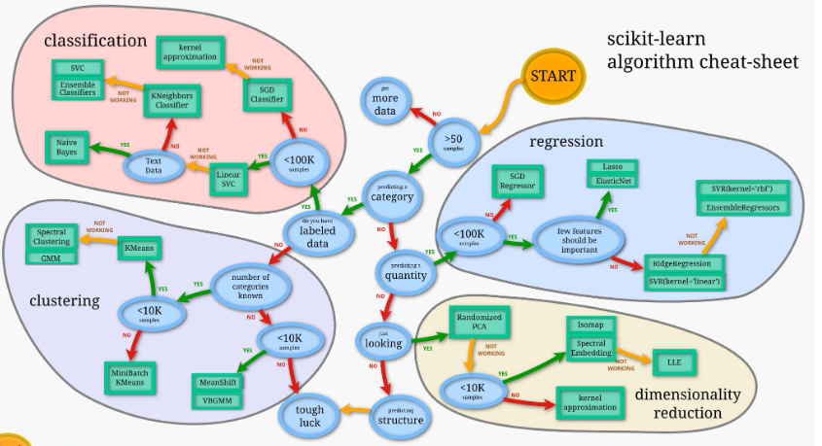
Types of Recognition
https://www.nrel.gov/energyexecs/assets/pdfs/artificial-intellegence-and-machine-learning.pdf
Notes:
Basic AI – classification, pattern recognition, natural language processing (and speech recognition), ocr

Slide 37

What We See
http://www.shodor.org/interactivate1.0/discussions/tessillusion.html
Notes:
We tend to see what we’re looking for – how much of our perception is inference
Optical illusions
Duck-Rabbit
Confirmation bias and all that
It’s hard for us to see new thing
human errors in recognitions - https://www.
nopsema.gov.au/resources/human-factors/human-error/

Slide 38
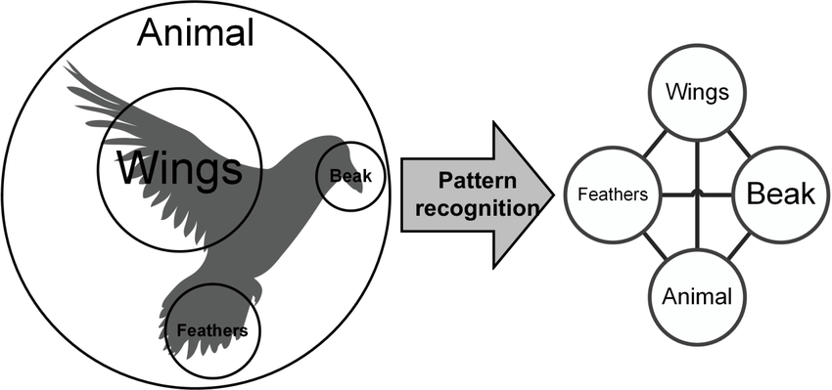
AI-based evaluation
Notes:
Examples
- Ballet - https://sportsmedicine-open.springeropen.com/articles/10.1186/s40798-020-0237-5
Using AWS Rekognition To Automatically Grade Surgical Residents - Thoughts?
Baseball analytics
Construction site - Buildots is developing an image recognition system that monitors every detail of an ongoing construction project and flags up delays or errors automatically. - https://www.technologyreview.com/2020/10/16/1010617/ai-image-recognition-construction-computer-vision-costs-delays/
Medical - https://www.futurity.org/rash-selfies-lyme-disease-artificial-intelligence-2456202-2/ - AI checks out ‘rash selfies’ to detect Lyme disease
Fitness apps - applying pose estimation in fitness are Kaia, VAI Fitness Coach, Ally apps, or the Millie Fit device. - https://www.infoq.com/articles/human-pose-estimation-ai-powered-fitness-apps/?utm_campaign=infoq_content&utm_source=infoq&utm_medium=feed&utm_term=global
How normal are you? https://www.hownormalami.eu/

Slide 39
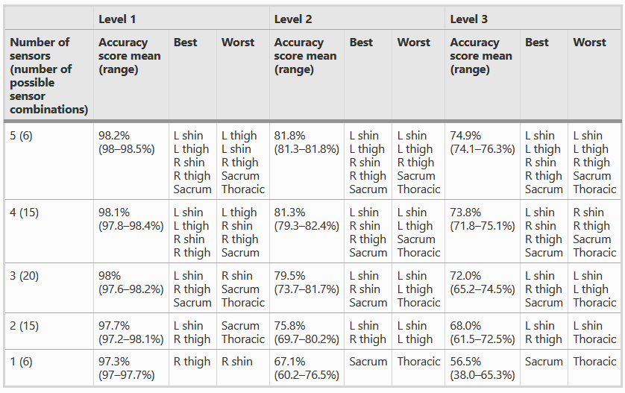
Ballet
https://sportsmedicine-open.springeropen.com/articles/10.1186/s40798-020-0237-5

Slide 40
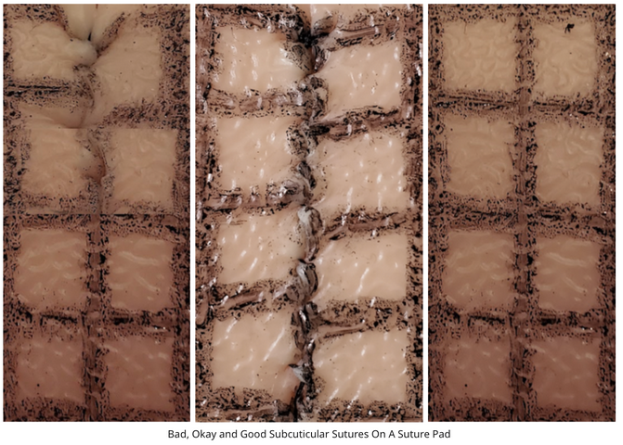
Surgery
Using AWS Rekognition To Automatically Grade Surgical Residents
https://www.reddit.com/r/MachineLearning/comments/jgx2yy/d_using_aws_rekognition_to_automatically_grade/
Notes:
Using AWS Rekognition To Automatically Grade Surgical Residents
https://www.reddit.com/r/MachineLearning/comments/jgx2yy/d_using_aws_rekognition_to_automatically_grade/

Slide 41
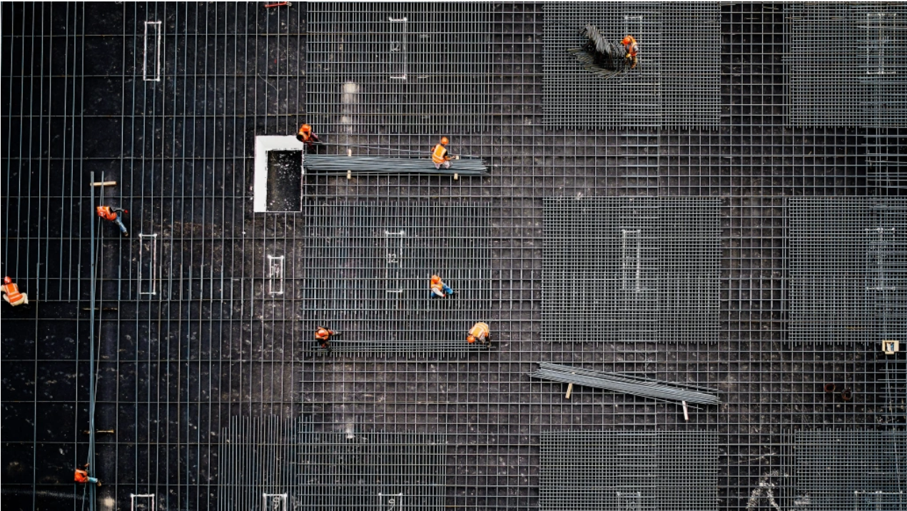
Construction
Buildots https://www.technologyreview.com/2020/10/16/1010617/ai-image-recognition-construction-computer-vision-costs-delays/
Notes:
https://www.technologyreview.com/2020/10/16/1010617/ai-image-recognition-construction-computer-vision-costs-delays/
Buildots is developing an image recognition system that monitors every detail of an ongoing construction project and flags up delays or errors automatically. It is already being used by two of the biggest building firms in Europe, including UK construction giant Wates in a handful of large residential builds. Construction is essentially a kind of manufacturing, says Danon. If high-tech factories now use AI to manage their processes, why not construction sites?

Slide 42
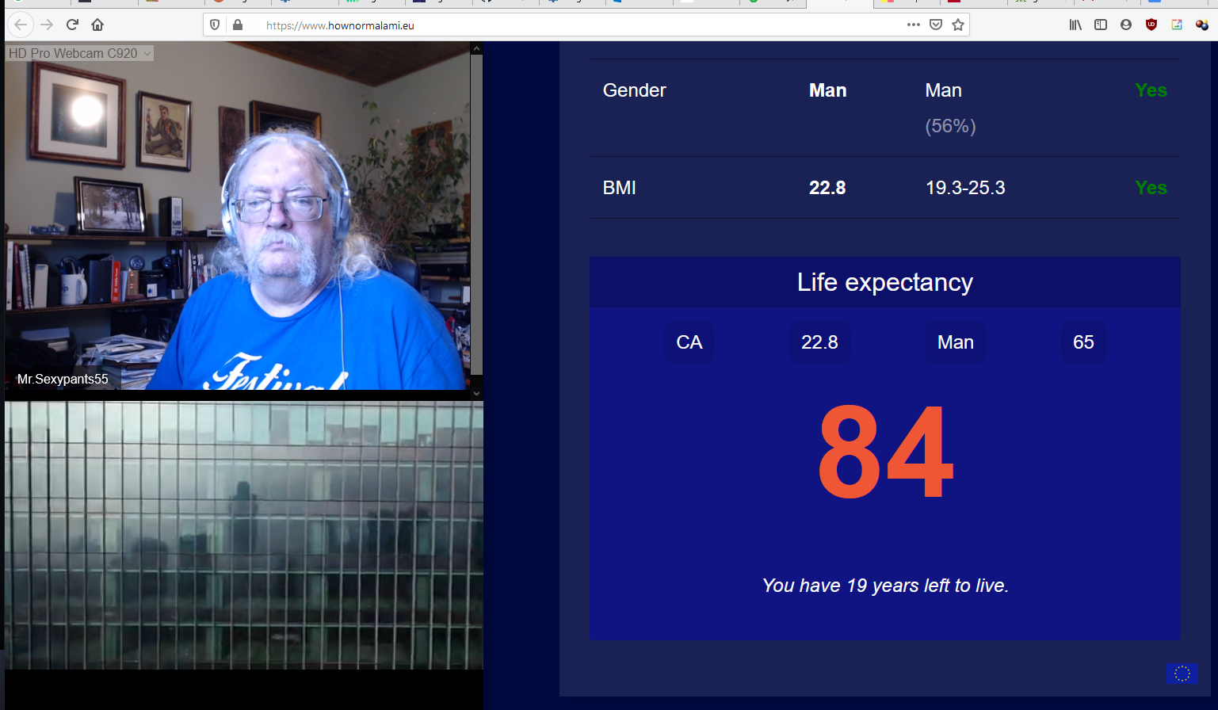
How Normal Are You?
Tijmen Schep https://www.hownormalami.eu/
Notes:
How Normal Am I?
Tijmen Schep
https://www.hownormalami.eu/

Slide 43
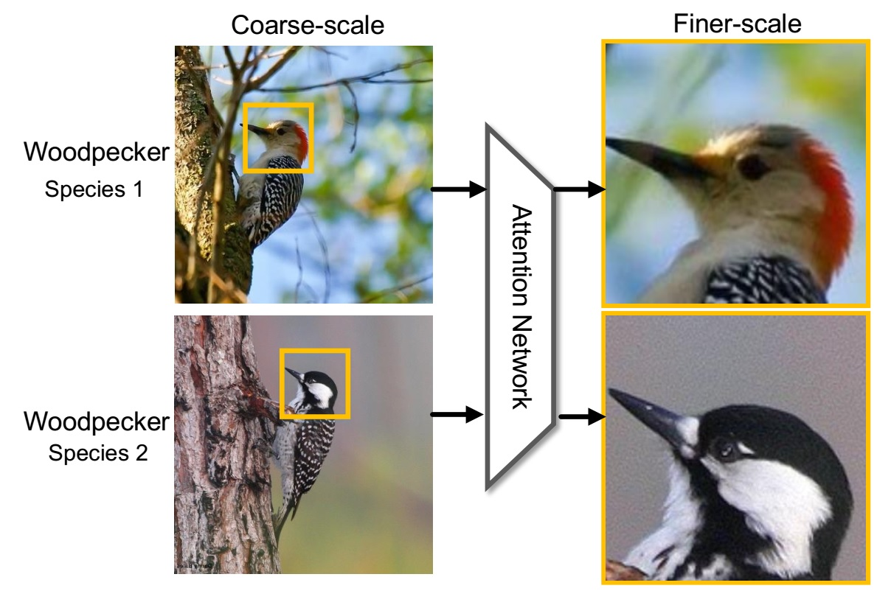
Recognition Networks

Slide 44
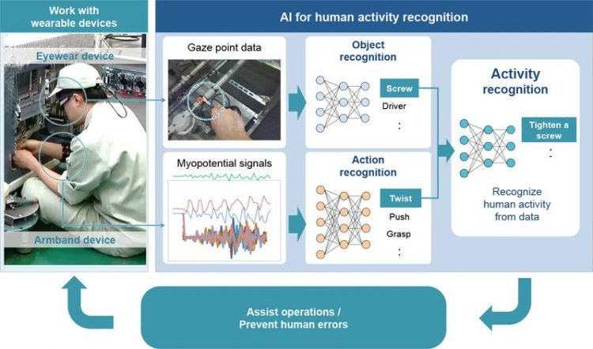
Activity Recognition
https://www.innovations-report.com/information-technology/dfki-and-hitachi-jointly-develop-ai-technology-for-human-activity-recognition-of-workers/
https://ieeexplore.ieee.org/abstract/document/5370804
Notes:
The goal of activity recognition is to recognize common human activities in real-life settings. Accurate activity recognition is challenging because human activity is complex and highly diverse. Researchers have used several probability-based algorithms to build activity models. The hidden Markov model (HMM) and the conditional random field (CRF) are among the most popular modeling techniques. - https://ieeexplore.ieee.org/abstract/document/5370804
Eunju Kim; Sumi Helal; Diane Cook. Human Activity Recognition and Pattern Discovery, in IEEE Pervasive Computing, vol. 9, no. 1, pp. 48-53, Jan.-March 2010, doi: 10.1109/MPRV.2010.7. https://ieeexplore.ieee.org/abstract/document/5370804
“Complementing the idea of activity recognition is automatically recognizing activity patterns in an unsupervised fashion. Tracking only preselected activities ignores important insights that other discovered patterns can provide on the residents' habits and the nature of the environment. In addition, recognizing and tracking automatically discovered activities eliminates the need to prelabel data and use It to train recognition algorithms.”
Also: https://www.innovations-report.com/information-technology/dfki-and-hitachi-jointly-develop-ai-technology-for-human-activity-recognition-of-workers/

Slide 45
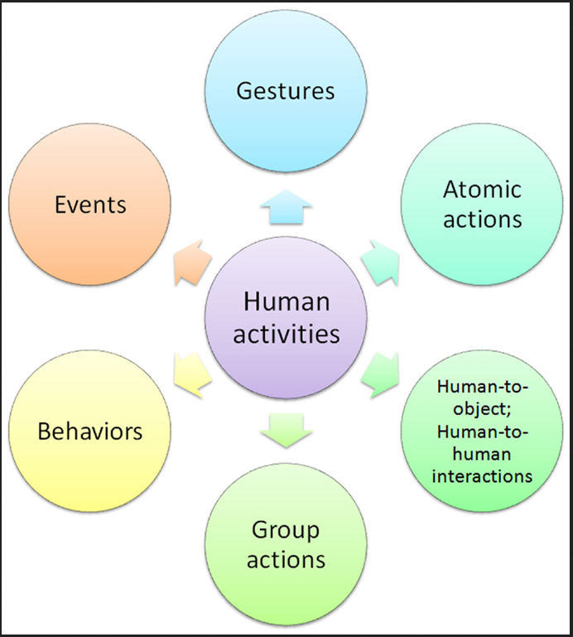
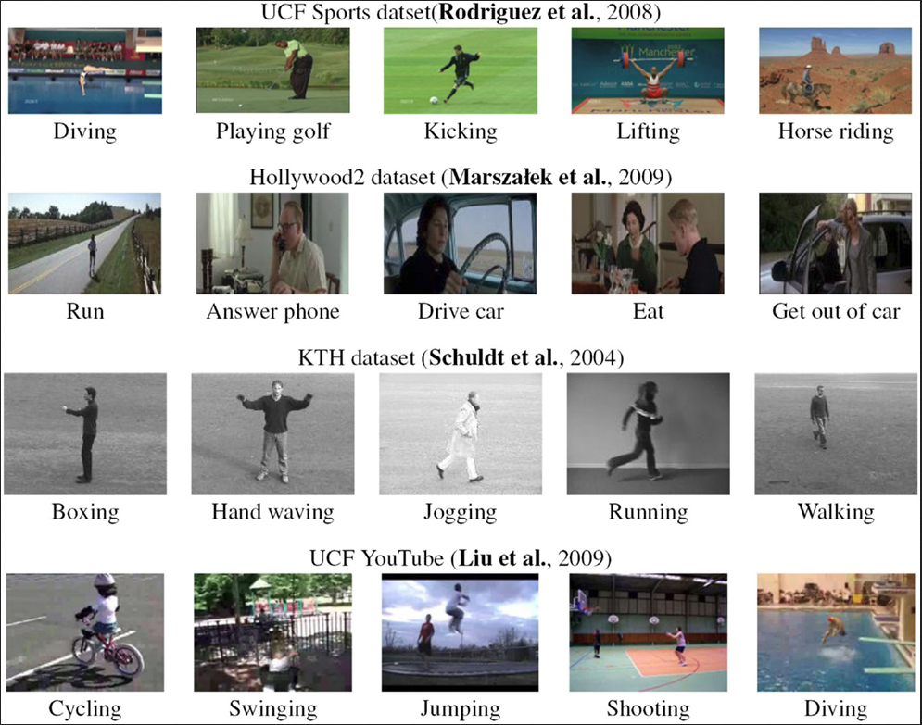
Methods
https://www.frontiersin.org/articles/10.3389/frobt.2015.00028/full
Notes:
Michalis Vrigkas, Christophoros Nikou and Ioannis A. Kakadiaris. A Review of Human Activity Recognition Methods
Frontiers in Robotics & AI, 16 November 2015 | https://doi.org/10.3389/frobt.2015.00028
https://www.frontiersin.org/articles/10.3389/frobt.2015.00028/full
Unimodal methods represent human activities from data of a single modality, such as images, and they are further categorized as: (i) space-time, (ii) stochastic, (iii) rule-based, and (iv) shape-based methods.
Multimodal methods combine features collected from different sources (Wu et al., 2013) and are classified into three categories: (i) affective, (ii) behavioral, and (iii) social networking methods.
Affective methods represent human activities according to emotional communications and the affective state of a person (Liu et al., 2011b; Martinez et al., 2014). Behavioral methods aim to recognize behavioral attributes, non-verbal multimodal cues, such as gestures, facial expressions, and auditory cues (Song et al., 2012a; Vrigkas et al., 2014b). Finally, social networking methods model the characteristics and the behavior of humans in several layers of human-to-human interactions in social events from gestures, body motion, and speech (Patron-Perez et al., 2012; Marín-Jiménez et al., 2014).
Space-time methods involve activity recognition methods, which represent human activities as a set of spatiotemporal features (Shabani et al., 2011; Li and Zickler, 2012) or trajectories (Li et al., 2012; Vrigkas et al., 2013). Stochastic methods recognize activities by applying statistical models to represent human actions (e.g., hidden Markov models) (Lan et al., 2011; Iosifidis et al., 2012a). Rule-based methods use a set of rules to describe human activities (Morariu and Davis, 2011; Chen and Grauman, 2012). Shape-based methods efficiently represent activities with high-level reasoning by modeling the motion of human body parts (Sigal et al., 2012b; Tran et al., 2012).
---
Also: https://shonan.nii.ac.jp/docs/No-066.pdf
https://www.researchgate.net/figure/Different-types-of-daily-human-activities_fig2_336327558

Slide 46
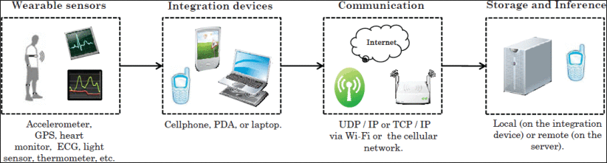
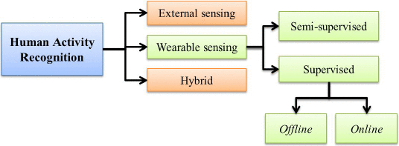
Common Technologies
https://ieeexplore.ieee.org/abstract/document/6365160
Notes:
Tech:
- sensors - https://ieeexplore.ieee.org/abstract/document/6365160 , https://dl.acm.org/doi/abs/10.1145/2499621
Smartphones - https://www.semanticscholar.org/paper/A-Public-Domain-Dataset-for-Human-Activity-using-Anguita-Ghio/83de43bc849ad3d9579ccf540e6fe566ef90a58e?p2df , https://www.sciencedirect.com/science/article/pii/S0925231215010930
Video - https://www.mdpi.com/2073-431x/2/2/88

Slide 47
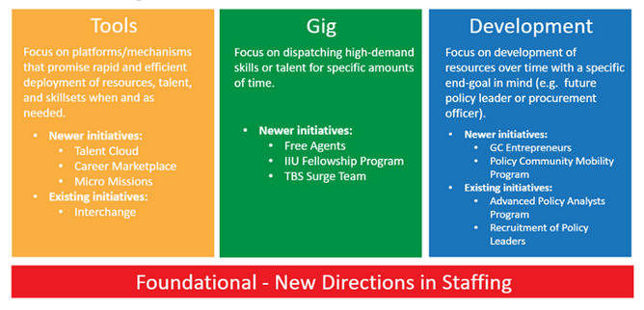
Applications
Laura Portal Avelar GC_Innovations https://medium.com/gc-entrepreneur/innovative-staffing-eb541920e18a
Notes:
Laura Portal Avelar GC_Innovations 2019 https://medium.com/gc-entrepreneur/innovative-staffing-eb541920e18a
Illustration of the 3 streams: Tools & Platforms, Gig, and Development as well as definitions and examples.
Recommender engines
Matching programs (eg for VC)
Recruiting networks
Emotion recognition
TBS Micromissions project
https://blog.canada.ca/2019/11/15/micro-mission.html
https://www.pandologic.com/recruiting-with-ai/

Slide 48
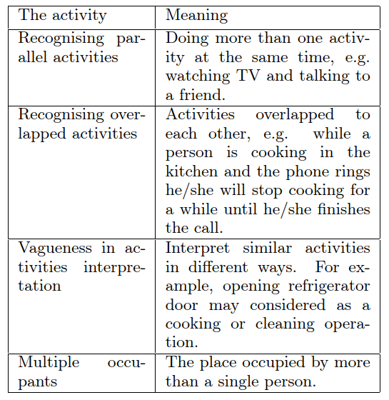

Technical Challenges
https://www.researchgate.net/figure/The-challenges-in-human-activities-recognition_tbl1_292140482
Notes:
Issues
, the nature of human activities poses the following challenges:
Recognizing concurrent activities. People can do several activities at the same time,¹ such as watching television while talking to friends. These behaviors should be recognized using a different approach from that for sequential activity.
Recognizing interleaved activities. Certain real-life activities can be interleaved¹. For instance, if a friend calls while you're cooking, you'd talk to your friend for a while, while you continue to cook.
Ambiguity of interpretation. Similar situations can be interpreted differently. For example, an “open refrigerator” can belong to several activities, such as “cooking” or “cleaning.”
Multiple residents. More than one resident can be present in many environments. A smart space—for example, a smart house—needs to recognize the activities residents perform in parallel, even when a group performs them.
https://ieeexplore.ieee.org/abstract/document/5370804
The development of a fully automated human activity recognition system is a non-trivial task due to cluttered backgrounds, complex camera motion, large intraclass variations, and data acquisition issues.
Also:
Lotfi, Ahmad & Elbayoudi, Abubaker & Langensiepen, Caroline & Appiah, Kofi. (2015). Modelling and simulation of activities of daily living representing an older adult's behaviour. 10.1145/2769493.2769544.
(source of image)

Slide 49
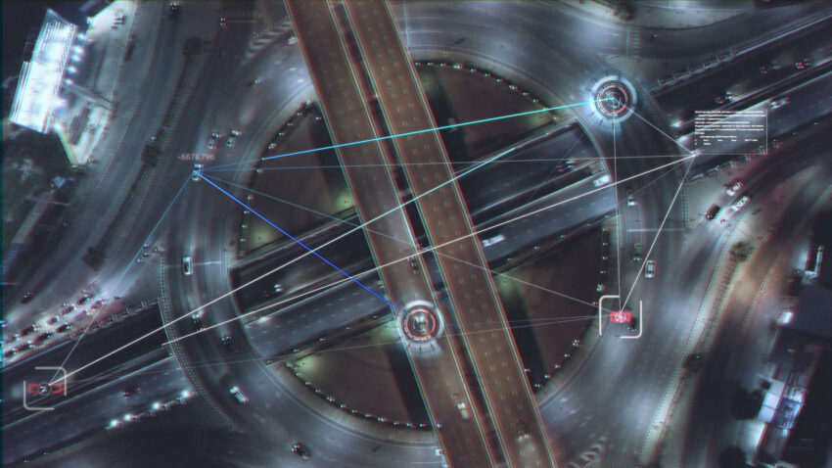
Ethical Challenges
https://hbr.org/2020/10/a-practical-guide-to-building-ethical-ai
Notes:
What Not to Do
the academic approach - “For the most part, academics ask, “Should we do this? Would it be good for society overall? Does it conduce to human flourishing?” Businesses, on the other hand, tend to ask, “Given that we are going to do this, how can we do it without making ourselves vulnerable to ethical risks?””
the “on-the-ground” approach - “engineers, data scientists, and product managers…. lack, however, is the kind of training that academics receive. As a result, they do not have the skill, knowledge, and experience to answer ethical questions systematically, exhaustively, and efficiently. They also lack a critical ingredient: institutional support.”
high-level AI ethics principles - The difficulty comes in operationalizing those principles. What, exactly, does it mean to be for “fairness?”
See article for framework
https://hbr.org/2020/10/a-practical-guide-to-building-ethical-ai

Slide 50
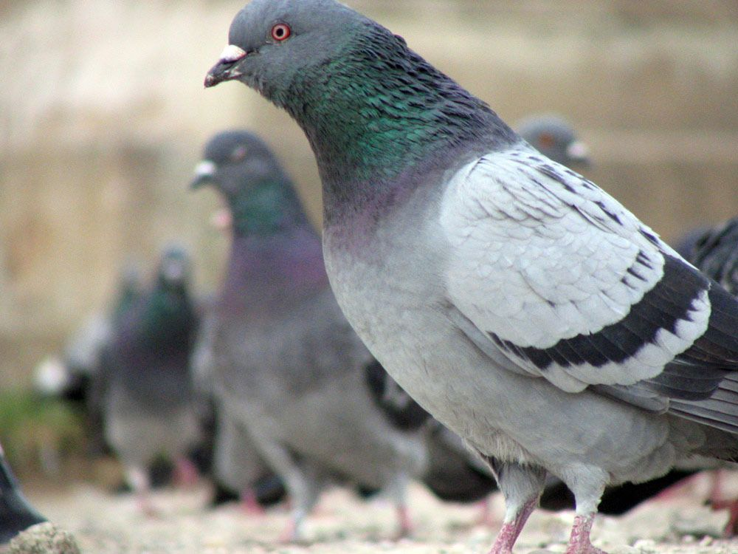
Challenges in Human Activity Recognition
Notes:
Issues
, the nature of human activities poses the following challenges:
Recognizing concurrent activities. People can do several activities at the same time,¹ such as watching television while talking to friends. These behaviors should be recognized using a different approach from that for sequential activity.
Recognizing interleaved activities. Certain real-life activities can be interleaved¹. For instance, if a friend calls while you're cooking, you'd talk to your friend for a while, while you continue to cook.
Ambiguity of interpretation. Similar situations can be interpreted differently. For example, an “open refrigerator” can belong to several activities, such as “cooking” or “cleaning.”
Multiple residents. More than one resident can be present in many environments. A smart space—for example, a smart house—needs to recognize the activities residents perform in parallel, even when a group performs them.
https://ieeexplore.ieee.org/abstract/document/5370804
The development of a fully automated human activity recognition system is a non-trivial task due to cluttered backgrounds, complex camera motion, large intraclass variations, and data acquisition issues.
What Not to Do
the academic approach - “For the most part, academics ask, “Should we do this? Would it be good for society overall? Does it conduce to human flourishing?” Businesses, on the other hand, tend to ask, “Given that we are going to do this, how can we do it without making ourselves vulnerable to ethical risks?””
the “on-the-ground” approach - “engineers, data scientists, and product managers…. lack, however, is the kind of training that academics receive. As a result, they do not have the skill, knowledge, and experience to answer ethical questions systematically, exhaustively, and efficiently. They also lack a critical ingredient: institutional support.”
high-level AI ethics principles - The difficulty comes in operationalizing those principles. What, exactly, does it mean to be for “fairness?”
See article for framework
https://hbr.org/2020/10/a-practical-guide-to-building-ethical-ai

Slide 51
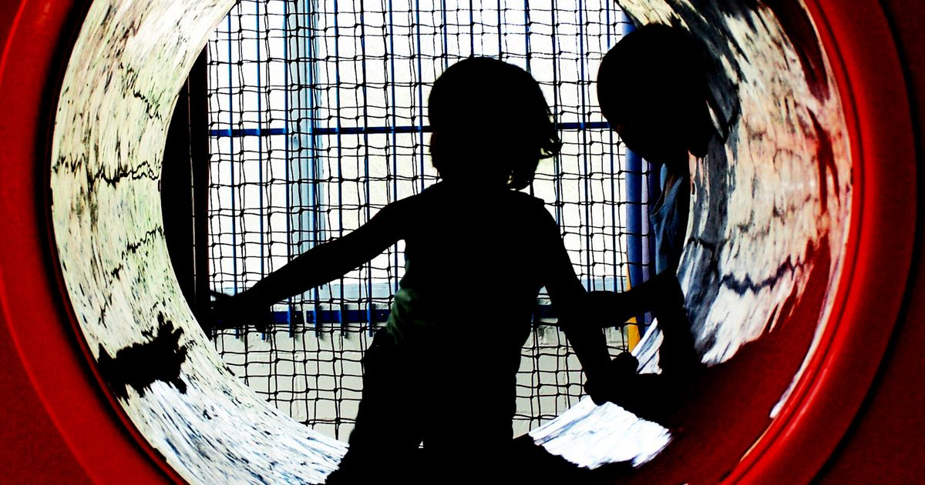
Invisibility
https://schoolsweek.co.uk/making-the-vulnerable-visible-is-how-we-will-close-gaps/
Notes:
Making the vulnerable visible - https://schoolsweek.co.uk/making-the-vulnerable-visible-is-how-we-will-close-gaps/
Harry Quilter-Pinner and Kiran Gill
“But to address youth unemployment, rising youth violence and serious mental health problems, we must also recognise the vital and costly work their schools do to keep them safe and help them succeed, especially at the higher levels of need.”
Also: favouring the beautiful people on Instagram, TikTok
Instagram row over plus-size model forces change to nudity policy
Nosheen Iqbal, theguardian.com https://www.theguardian.com/technology/2020/oct/25/instagram-row-over-plus-size-model-forces-change-to-nudity-policy
Invisible Censorship. TikTok Told Moderators to Suppress Posts by “Ugly” People and the Poor to Attract New Users. The Intercept. Sam Biddle, Paulo Victor Ribeiro, Tatiana Dias, March 16 2020
https://theintercept.com/2020/03/16/tiktok-app-moderators-users-discrimination/
Image: https://img.huffingtonpost.com/asset/5d011bed250000ae13dc41b2.jpeg?ops=1200_630 from https://www.huffingtonpost.co.uk/katharine-sacks-jones/vulnerable-women_b_9608326.html

Slide 52
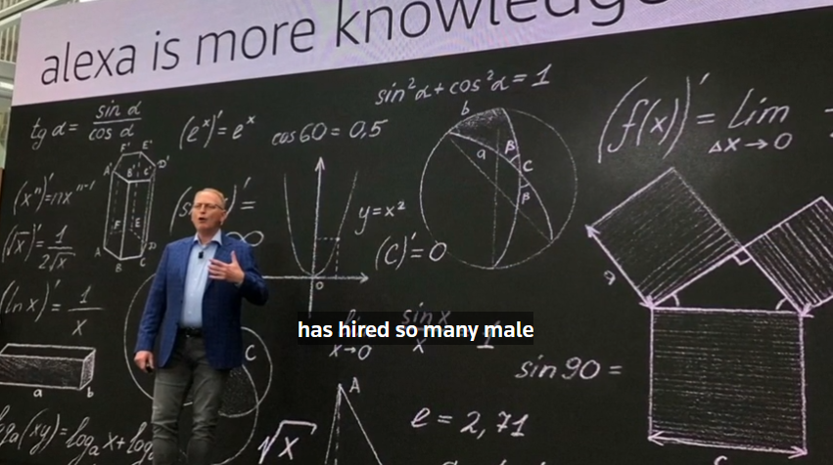
Bias
https://fortune.com/2018/10/10/amazon-ai-recruitment-bias-women-sexist/
Notes:
Issues:
For example, Amazon engineers reportedly spent years working on AI hiring software, but eventually scrapped the program because they couldn’t figure out how to create a model that doesn’t systematically discriminate against women.
October 10, 2018 Amazon scraps secret AI recruiting tool that showed bias against women
By Jeffrey Dastin, Reuters https://www.reuters.com/article/us-amazon-com-jobs-automation-insight-idUSKCN1MK08G
Amazon Reportedly Killed an AI Recruitment System Because It Couldn’t Stop the Tool from Discriminating Against Women, David Meyer, Fortune. October 10, 2018 6:00 AM EDT https://fortune.com/2018/10/10/amazon-ai-recruitment-bias-women-sexist/

Slide 53

Explainability, Interpretability
https://iapp.org/news/a/the-privacy-pros-guide-to-explainability-in-machine-learning/
Notes:
Interpretability has to do with how accurate a machine learning model can associate a cause to an effect. Explainability has to do with the ability of the parameters, often hidden in Deep Nets, to justify the results.
https://www.bmc.com/blogs/machine-learning-interpretability-vs-explainability/ July 16, 2020
BMC Blog, Jonathan Johnson
Image: Stuart Shirrell Privacy Tech April 13, 2018u https://iapp.org/news/a/the-privacy-pros-guide-to-explainability-in-machine-learning/
Explainability - the oft-lauded value of explainability in AI, a highly valued feature of ML models that will likely be part of your framework. Standard machine-learning algorithms engage in pattern recognition too unwieldy for humans to grasp. But it is common — particularly when the outputs of the AI are potentially life-altering — to want or demand explanations for AI outputs. The problem is that there is often a tension between making outputs explainable, on the one hand, and making the outputs (e.g. predictions) accurate, on the other. https://hbr.org/2020/10/a-practical-guide-to-building-ethical-ai

Slide 54

Surveillance Culture
David Lyon https://ijoc.org/index.php/ijoc/article/download/5527/1933&usg=AOvVaw1wQCFgARRSAPM6HjEK4ILv
Notes:
It’s not just cameras and the state… as Lyons says, it extends to the whole sharing culture
David Lyon (Queens) “Surveillance Culture: Engagement, Exposure and Ethics in Digital Modernity” The International Journal of Communication. 11, 2017. https://ijoc.org/index.php/ijoc/article/download/5527/1933&usg=AOvVaw1wQCFgARRSAPM6HjEK4ILv
This article argues for a careful, critical, and cultural analysis of surveillance situations. It
suggests that we go beyond common designations such as surveillance state and surveillance society. But
it is also worth picking up a strand from the start of the article, that the Snowden disclosures are better
understood if considerations concerning surveillance culture are drawn into the mix.
As surveillance culture grows, can we even hope to escape its reach?
Kenan Malik, the Guardian, Sun 19 May 2019 06.40 BST, https://www.theguardian.com/commentisfree/2019/may/19/as-surveillance-culture-grows-can-we-even-hope-to-escape-its-reach
The Road to Digital Serfdom? The Visible Hand of Surveillance Capitalism
Shoshana Zuboff, ProMarket, February 22, 2019
https://promarket.org/2019/02/22/road-to-digital-serfdom-surveillance-capitalism-visible-hand/

Slide 55

Open Recognition Networks
Notes:
Our new role
That needs to be in place

Slide 56

e-Portfolios
https://www.informationweek.com/software/7-ways-to-create-e-portfolios/d/d-id/1110673
https://electronicportfolios.org/balance/Balancing2.htm
Notes:
https://www.informationweek.com/software/7-ways-to-create-e-portfolios/d/d-id/1110673
Types: in LMS, using Google, stand-alone
2 faces of e-portfolios
https://electronicportfolios.org/balance/Balancing2.htm

Slide 57

Activity Records
https://xapi.com/overview/
https://xapi.com/learning-record-store/
Notes:
https://xapi.com/overview/ XAPI
https://xapi.com/learning-record-store/ LRS
Enterprise: data marts, data lakes, etc etc
The Experience API (or xAPI) is a new specification for learning technology that makes it possible to collect data about the wide range of experiences a person has (online and offline). This API captures data in a consistent format about a person or group’s activities from many technologies. Very different systems are able to securely communicate by capturing and sharing this stream of activities using xAPI’s simple vocabulary.
The LRS is the heart of any xAPI ecosystem, receiving, storing and returning xAPI statements. You’ll need an LRS in order to do anything with xAPI. Every other tool which sends or retrieves learning activity data will interact with the LRS as the central store.
The LRS, as defined by the xAPI specification, is “a server (i.e. system capable of receiving and processing web requests) that is responsible for receiving, storing, and providing access to Learning Records.” Taking this a step farther, the LRS is designed to enable systems to store and retrieve xAPI statements, store xAPI state, and store various other xAPI metadata from other systems. When considering what an LRS actually is, it’s important to remember that the S stands for STORE, meaning that the most basic function of an LRS is to store and make available xAPI statements.

Slide 58

Ownership and Choice
https://blocs.xtec.cat/portfolioproject/2009/07/24/portfolioroadmap/
Notes:
“Here is a map for eportfolio making I have come up with. Based on David Delgado’s PLE and Derek Wenmoth via Helen Barrett’s blog.
My goal is to highlight the steps of the process and I am not too sure about the first part yet… I might change it in the future. The first part, doing tasks/projects is the largest part of the student’s work, supported by different formats, text, audio, video, image and hyperlinked to collaborate connected in the making of activities in web 2.o support.” Sònia Guilana https://blocs.xtec.cat/portfolioproject/2009/07/24/portfolioroadmap/

Slide 59

Platforms
Federated Networks - https://monoskop.org/Federated_networks
Notes:
Federated networks – complete guide - https://monoskop.org/Federated_networks
Nextcloud - https://nextcloud.com/
Bonfire - Your plug & play federated social network: - https://bonfire.cafe/
Freedombone – Freedombone is a home server system which enables you to run your own internet services, individually or as a household. It includes all of the things you'd expect such as email, chat, VoIP, web sites, wikis, blogs, social networks, media hosting and more. https://freedombone.net/
Image: https://www.semanticscholar.org/paper/Auction-Based-Algorithms-for-Routing-and-Task-in-Ehsanfar-Grogan/1323053b819de6d46236c0657d3147446fc8993d

Slide 60
Challenges
Notes:
potential social, ethical and cultural challenges such systems introduce.
What’s the right network structure
https://medium.com/gc-entrepreneur/evaluation-framework-for-innovative-human-resources-hr-initiatives-1628d1ce1d84 Evaluation Framework for Innovative Human Resources (HR) Initiatives
Melissa Poon GC_Innovations Nov 29, 2019

Slide 61

Thank You
https://www.downes.ca
Notes:
https://www.downes.ca

